Slide 1
Python Class 11 Series
Unit 1: Number System
Saroj Kumar Jha
Saroj Codes
Please subscribe

Slide 2
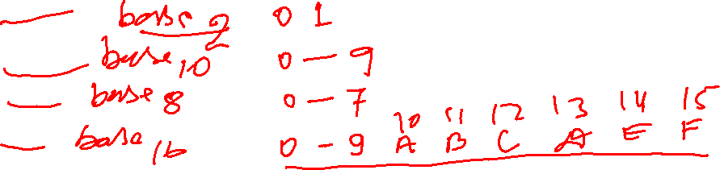
Binary
Decimal
Octal
Hexa

Slide 3
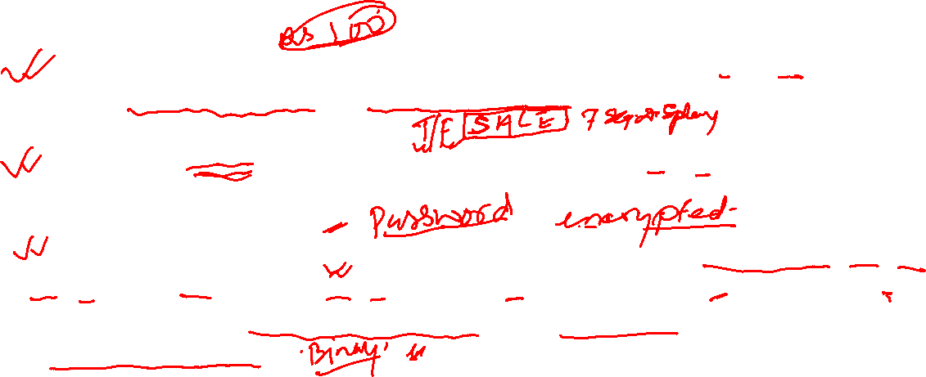
Number System
A number system is a mathematical system used to represent and manipulate numbers. It provides a way to express quantities and perform arithmetic operations. The most used number system is the decimal system, also known as the base-10 system, which uses ten digits (0-9) to represent numbers.
Binary System (Base-2): The binary system uses only two digits, 0 and 1. It is widely used in computer systems and digital electronics because it directly corresponds to the on/off states of electronic switches.
Octal System (Base-8): The octal system uses eight digits, 0 to 7. It is used in some computer programming and system permissions because it provides a more compact representation than binary.
Hexadecimal System (Base-16): The hexadecimal system uses sixteen digits, 0 to 9 and A to F, where A represents 10, B represents 11, and so on up to F representing 15. It is commonly used in computer programming and digital systems to represent binary values more concisely.

Slide 4
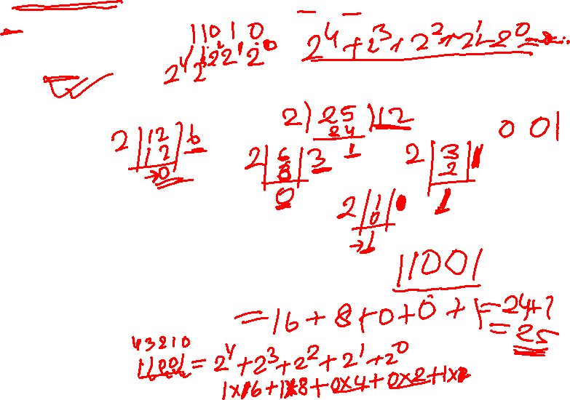
Binary Number
The binary system, also known as the base-2 system, uses only two digits: 0 and 1. Each digit's position in a binary number represents a power of 2.
Let's take an example and convert a decimal number to binary.
Example: Let's convert the decimal number 25 to binary.
To convert a decimal number to binary, we divide the decimal number by 2 repeatedly and keep track of the remainders. We continue dividing until we reach zero.
Here's the step-by-step process:
Start with the decimal number 25.
Divide 25 by 2: 25 ÷ 2 = 12 remainder 1. Write down the remainder (1) as the rightmost digit of the binary number.
Divide 12 by 2: 12 ÷ 2 = 6 remainder 0. Write down the remainder (0) as the next digit to the left.
Divide 6 by 2: 6 ÷ 2 = 3 remainder 0. Write down the remainder (0) to the left.
Divide 3 by 2: 3 ÷ 2 = 1 remainder 1. Write down the remainder (1) to the left.
Divide 1 by 2: 1 ÷ 2 = 0 remainder 1. Write down the remainder (1) to the left.
Since we have reached zero, we stop dividing.
The remainders we obtained while dividing are read from bottom to top, giving us the binary representation of 25: 25(decimal) = 11001(binary)
So, the binary representation of the decimal number 25 is 11001.

Slide 5
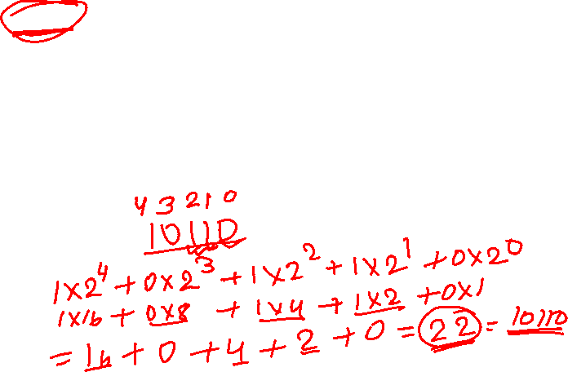
Binary Number
To convert a binary number to decimal, you need to understand the positional value of each digit in the binary system.
Here's an example to convert a binary number to decimal:
Example: Let's convert the binary number 10110 to decimal.
To convert a binary number to decimal, you need to multiply each digit by the corresponding power of 2 and then sum up the results.
In the binary number 10110, we have five digits from left to right. We assign a positional value to each digit based on its position, starting from the rightmost digit as 2^0, the next digit as 2^1, then 2^2, and so on.
Let's break down the conversion:
Digit positions: 2^4 2^3 2^2 2^1 2^0 Binary number: 1 0 1 1 0
To convert to decimal, we multiply each digit by its corresponding positional value and sum up the results:
(1 * 2^4) + (0 * 2^3) + (1 * 2^2) + (1 * 2^1) + (0 * 2^0)
Simplifying the expression:
(1 * 16) + (0 * 8) + (1 * 4) + (1 * 2) + (0 * 1)
16 + 0 + 4 + 2 + 0 = 22
So, the binary number 10110 is equivalent to the decimal number 22.

Slide 6
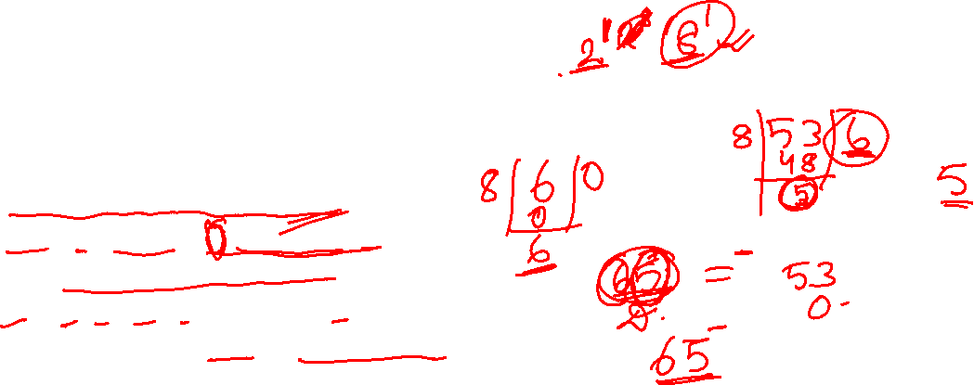
Octal Number
An octal number is a number system that uses a base of 8. It uses eight digits: 0, 1, 2, 3, 4, 5, 6, and 7. Each digit's position in an octal number represents a power of 8.
Let's take an example and convert a decimal number to octal.
Example: Let's convert the decimal number 53 to octal.
To convert a decimal number to octal, we divide the decimal number by 8 repeatedly and keep track of the remainders. We continue dividing until we reach zero.
Here's the step-by-step process:
Start with the decimal number 53.
Divide 53 by 8: 53 ÷ 8 = 6 remainder 5. Write down the remainder (5) as the rightmost digit of the octal number.
Divide 6 by 8: 6 ÷ 8 = 0 remainder 6. Write down the remainder (6) to the left.
Since we have reached zero, we stop dividing.
The remainders we obtained while dividing are read from bottom to top, giving us the octal representation of 53: 53(decimal) = 65(octal)
So, the octal representation of the decimal number 53 is 65.

Slide 7
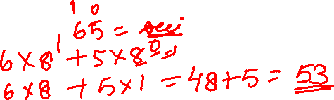
Octal Number
To convert an octal number to decimal, you need to understand the positional value of each digit in the octal system.
Example: Let's convert the octal number 65 to decimal.
To convert an octal number to decimal, you need to multiply each digit by the corresponding power of 8 and then sum up the results.
In the octal number 65, we have two digits from left to right. We assign a positional value to each digit based on its position, starting from the rightmost digit as 8^0, the next digit as 8^1, then 8^2, and so on.
Let's break down the conversion: Digit positions: 8^1 8^0 Octal number: 6 5
To convert to decimal, we multiply each digit by its corresponding positional value and sum up the results: (6 * 8^1) + (5 * 8^0)
Simplifying the expression:
(6 * 8) + (5 * 1)
48 + 5 = 53 So, the octal number 65 is equivalent to the decimal number 53.

Slide 8
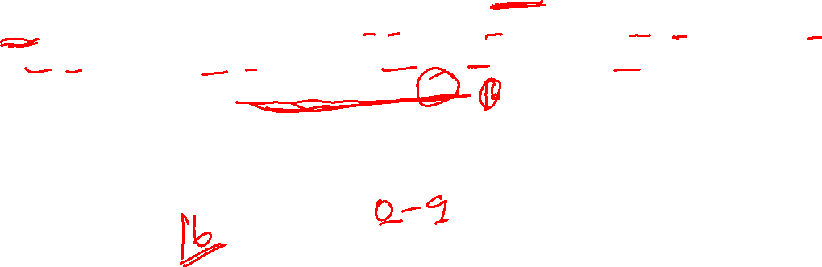
Hexadecimal Number
The hexadecimal number system, often referred to as "hex," is a number system that uses a base of 16. It uses sixteen digits: 0-9, and A-F, where A represents 10, B represents 11, C represents 12, D represents 13, E represents 14, and F represents 15. Each digit's position in a hexadecimal number represents a power of 16.
The hexadecimal system is commonly used in computer programming and digital systems to represent binary values more compactly. It is particularly useful for representing large binary numbers and memory addresses.

Slide 9
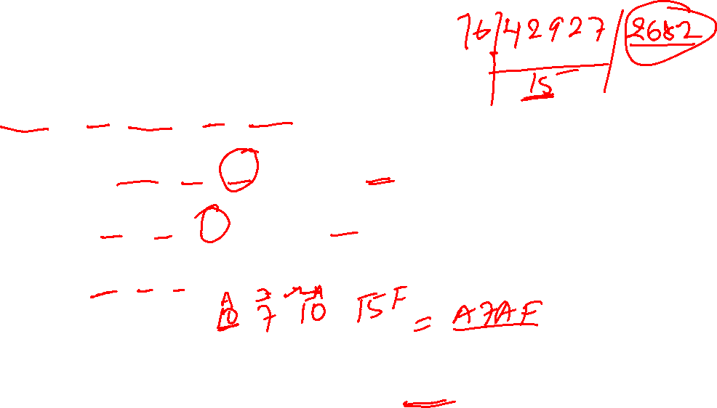
Hexadecimal Number
To convert the decimal number 42927 to hexadecimal, you can use a process similar to converting from decimal to any other base.
Here's the step-by-step process:
Start with the decimal number 42927.
Divide 42927 by 16: 42927 ÷ 16 = 2682 remainder 15. Write down the remainder (15=F) as the rightmost digit of the hexadecimal number.
Divide 2682 by 16: 2682 ÷ 16 = 167 remainder 10. Write down the remainder (10=A) to the left.
Divide 167 by 16: 167 ÷ 16 = 10 remainder 7. Write down the remainder (7) to the left.
Divide 10 by 16: 10 ÷ 16 = 0 remainder 10. Write down the remainder (10=A) to the left.
Since we have reached zero, we stop dividing.
The remainders we obtained while dividing are read from bottom to top, giving us the hexadecimal representation of 42927: 42927(decimal) = A7AF(hexadecimal)
So, the hexadecimal representation of the decimal number 42927 is A7AF.

Slide 10
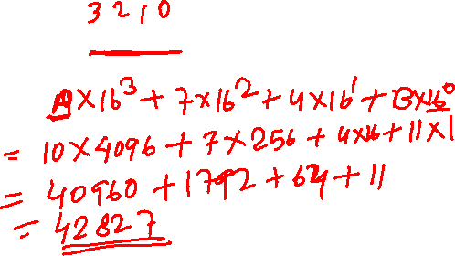
Hexadecimal Number
Let's convert the hexadecimal number A74B to decimal.
To convert a hexadecimal number to decimal, you need to multiply each digit by the corresponding power of 16 and then sum up the results.
In the hexadecimal number A74B, we have four digits from left to right: A, 7, 4, and B. We assign a positional value to each digit based on its position, starting from the rightmost digit as 16^0, the next digit as 16^1, then 16^2, and so on.
Let's break down the conversion:
Digit positions: 16^3 16^2 16^1 16^0 Hexadecimal number: A 7 4 B
To convert to decimal, we multiply each digit by its corresponding positional value and sum up the results:
(10 * 16^3) + (7 * 16^2) + (4 * 16^1) + (11 * 16^0)
Simplifying the expression:
(10 * 4096) + (7 * 256) + (4 * 16) + (11 * 1)
40960 + 1792 + 64 + 11 = 42827
So, the hexadecimal number A74B is equivalent to the decimal number 42827.

Slide 11
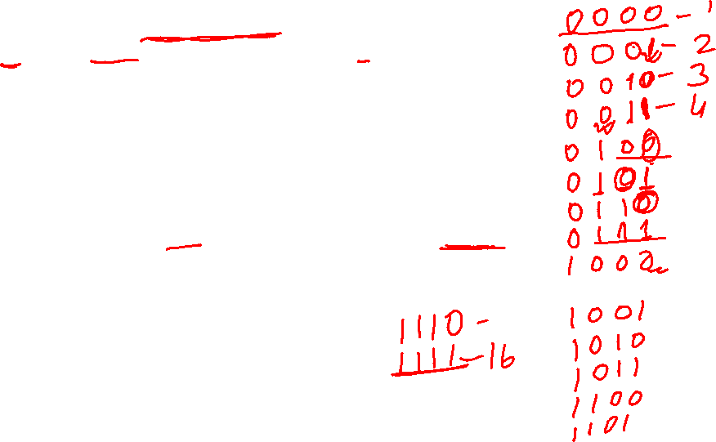
Number
To convert a hexadecimal number to binary, you can convert each hexadecimal digit to its corresponding 4-bit binary representation.
Identify each hexadecimal digit and its equivalent 4-bit binary representation:
1. Hexadecimal digit 0: Binary 0000 2. Hexadecimal digit 1: Binary 0001
3. Hexadecimal digit 2: Binary 0010 4. Hexadecimal digit 3: Binary 0011
5. Hexadecimal digit 4: Binary 0100 6. Hexadecimal digit 5: Binary 0101
7. Hexadecimal digit 6: Binary 0110 8. Hexadecimal digit 7: Binary 0111
9. Hexadecimal digit 8: Binary 1000 10. Hexadecimal digit 9: Binary 1001
11. Hexadecimal digit A: Binary 1010 12. Hexadecimal digit B: Binary 1011
13. Hexadecimal digit C: Binary 1100 14. Hexadecimal digit D: Binary 1101
15. Hexadecimal digit E: Binary 1110 16. Hexadecimal digit F: Binary 1111
Replace each hexadecimal digit in the given hexadecimal number with its corresponding 4-bit binary representation.
For example, let's convert the hexadecimal number A77F to binary:
A: 1010 7: 0111 7: 0111 F: 1111
So, the hexadecimal number A77F is equivalent to the binary number 101001110111111.

Slide 12
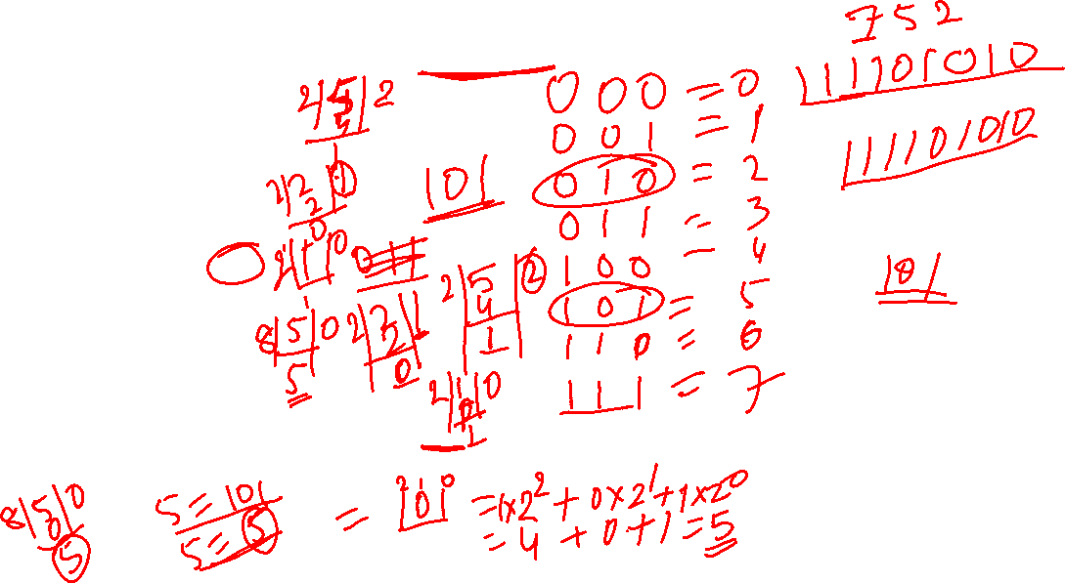
Number
To convert an octal number to binary, you can convert each octal digit to its corresponding 3-bit binary representation.
Identify each octal digit and its equivalent 3-bit binary representation:
Octal digit 0: Binary 000
Octal digit 1: Binary 001
Octal digit 2: Binary 010
Octal digit 3: Binary 011
Octal digit 4: Binary 100
Octal digit 5: Binary 101
Octal digit 6: Binary 110
Octal digit 7: Binary 111
Replace each octal digit in the given octal number with its corresponding 3-bit binary representation.
For example, let's convert the octal number 752 to binary:
7: 111 5: 101 2: 010 So, the octal number 752 is equivalent to the binary number 111101010.

Slide 13
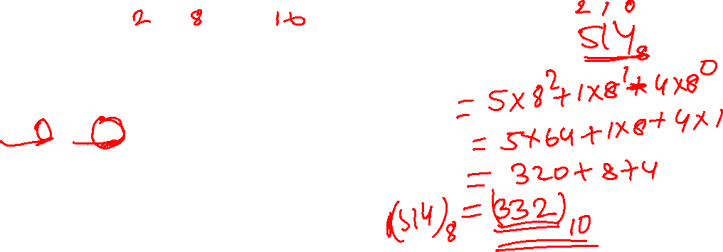
Number
Write base values of binary, octal and hexadecimal number system.
Ans: 2,8, and 16
Give full form of ASCII and ISCII.
Ans: American Standard Code for Information Interchange
3. Try the following conversions.
(i) (514)8 = (?)10 (iv) (4D9)16 = (?)10
(ii) (220)8 = (?)2 (v) (11001010)2 = (?)10
(iii) (76F)16 = (?)10 (vi) (1010111)2 = (?)10
Ans : i)
(514)₈ = 5 × 8² + 1 × 8¹ + 4 × 8⁰
Calculating the values:
(514)₈ = 5 × 64 + 1 × 8 + 4 × 1
= 320 + 8 + 4
= 332
Therefore, (514)₈ is equal to (332)₁₀ in decimal.

Slide 14
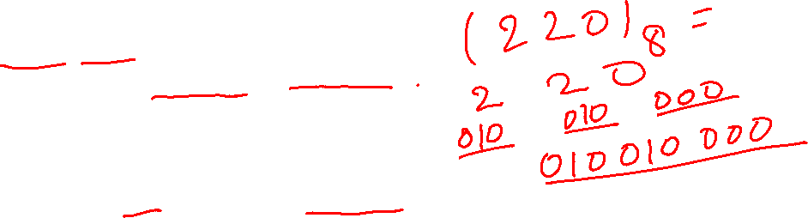
Number
ii)
(220)₈ = 2 2 0
The binary equivalent for each octal digit is:
2₈ = 010₂
2₈ = 010₂
0₈ = 000₂
Therefore, (220)₈ is equal to (010010000)₂ in binary.
iii)
(76F)₁₆ = 7 × 16² + 6 × 16¹ + F × 16⁰
The hexadecimal digit F is equivalent to 15 in decimal.
Calculating the values:
(76F)₁₆ = 7 × 256 + 6 × 16 + 15 × 1
= 1792 + 96 + 15
= 1903
Therefore, (76F)₁₆ is equal to (1903)₁₀ in decimal.

Slide 15
Number
iv)
(4D9)₁₆ = 4 × 16² + D × 16¹ + 9 × 16⁰
The hexadecimal digit D is equivalent to 13 in decimal.
Calculating the values:
(4D9)₁₆ = 4 × 256 + 13 × 16 + 9 × 1
= 1024 + 208 + 9
= 1241
Therefore, (4D9)₁₆ is equal to (1241)₁₀ in decimal.
v)
(11001010)₂ = 1 × 2⁷ + 1 × 2⁶ + 0 × 2⁵ + 0 × 2⁴ + 1 × 2³ + 0 × 2² + 1 × 2¹ + 0 × 2⁰
Calculating the values:
(11001010)₂ = 1 × 128 + 1 × 64 + 0 × 32 + 0 × 16 + 1 × 8 + 0 × 4 + 1 × 2 + 0 × 1
= 128 + 64 + 0 + 0 + 8 + 0 + 2 + 0
= 202
Therefore, (11001010)₂ is equal to (202)₁₀ in decimal.

Slide 16
Number
vi).
(1010111)₂ = 1 × 2⁶ + 0 × 2⁵ + 1 × 2⁴ + 0 × 2³ + 1 × 2² + 1 × 2¹ + 1 × 2⁰
Calculating the values:
(1010111)₂ = 1 × 64 + 0 × 32 + 1 × 16 + 0 × 8 + 1 × 4 + 1 × 2 + 1 × 1
= 64 + 0 + 16 + 0 + 4 + 2 + 1
= 87 , Therefore, (1010111)₂ is equal to (87)₁₀ in decimal.
4. Do the following conversions from decimal number to other number systems.
(i) (54)10 = (?)2 (iv) (889)10 = (?)8
(ii) (120)10 = (?)2 (v) (789)10 = (?)16
(iii) (76)10 = (?)8 (vi) (108)10 = (?)16
Ans:
i) 1. Divide the decimal number by 2. 2. Divide the quotient from step 1 by 2.
54 ÷ 2 = 27, with a remainder of 0. 27 ÷ 2 = 13, with a remainder of 1.
Repeat step 1 until the quotient becomes 0.
3. 13 ÷ 2 = 6, with a remainder of 1., 4. 6 ÷ 2 = 3, with a remainder of 0.
5. 3 ÷ 2 = 1, with a remainder of 1. , 6. 1 ÷ 2 = 0, with a remainder of 1.
Read the remainders from the last to the first to get the binary representation.
The remainders are 110110, so (54)₁₀ is equal to (110110)₂ in binary.

Slide 17
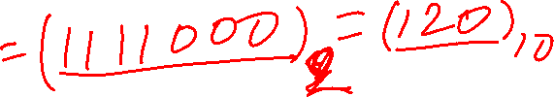
Number
ii) Divide the decimal number by 2.
120 ÷ 2 = 60, with a remainder of 0.
60 ÷ 2 = 30, with a remainder of 0.
30 ÷ 2 = 15, with a remainder of 0.
15 ÷ 2 = 7, with a remainder of 1.
7 ÷ 2 = 3, with a remainder of 1.
3 ÷ 2 = 1, with a remainder of 1.
1 ÷ 2 = 0, with a remainder of 1.
Read the remainders from the last to the first to get the binary representation.
iii)
Divide the decimal number by 8.
76 ÷ 8 = 9, with a remainder of 4.
9 ÷ 8 = 1, with a remainder of 1.
1 ÷ 8 = 0, with a remainder of 1.
Read the remainders from the last to the first to get the octal representation.
The remainders are 114, so (76)₁₀ is equal to (114)₈ in octal.

Slide 18
Number
iv) Divide the decimal number by 8.
889 ÷ 8 = 111, with a remainder of 1.
111 ÷ 8 = 13, with a remainder of 7.
13 ÷ 8 = 1, with a remainder of 5.
1 ÷ 8 = 0, with a remainder of 1.
Read the remainders from the last to the first to get the octal representation.
The remainders are 157, so (889)₁₀ is equal to (157)₈ in octal.
v)
Divide the decimal number by 16.
789 ÷ 16 = 49, with a remainder of 5.
49 ÷ 16 = 3, with a remainder of 1.
3 ÷ 16 = 0, with a remainder of 3.
Convert any remainders greater than 9 to their corresponding hexadecimal letters.
In this case, the remainders are 513, so the equivalent hexadecimal representation is (315)₁₆.

Slide 19
Number
vi)
Divide the decimal number by 16.
108 ÷ 16 = 6, with a remainder of 12.
6 ÷ 16 = 0, with a remainder of 6.
Convert any remainders greater than 9 to their corresponding hexadecimal letters.
In this case, the remainder 12 is equivalent to C in hexadecimal.
5. Express the following octal numbers into their equivalent decimal numbers.
(i) 145 (ii) 6760 (iii) 455 (iv) 10.75
Ans:
Digit 1 4 5
1x8^2 + 4x8^1 + 5x8^0
1 * 64 = 64 , 4 * 8 = 32, 5 * 1 = 5 = 64+32+5 =101
ii) Digit 6 7 6 0
6x8^3 + 7x8^2 + 6x8^1 + 0x8^1
6 * 512 = 3072, 7 * 64 = 448, 6 * 8 = 48, 0 * 1 = 0
3072+448+48+0 = 3568

Slide 20
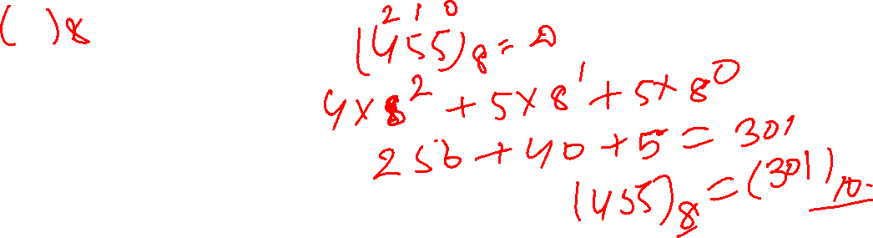
Number
iii) Digit 455
4x8^2 + 5x8^1 + 5x8^1
4 * 64 = 256, 5 * 8 = 40 , 5 * 1 = 5
256+40+5 = 301
iv)
For the fractional part 75: 7x8^-1 + 5x8^-2
7 * (1/8) + 5 * (1/64) = 7/8 + 5/64 = 56/64 + 5/64 = 61/64 =0.953
Now for 10
1x8^1+0x8^0 =8
8.953
6. Express the following decimal numbers into hexadecimal numbers.
(i) 548 (ii) 4052 (iii) 58 (iv) 100.25
Ans
i)
Divide 548 by 16. Quotient = 34, Remainder = 4. , Divide 34 by 16.
Quotient = 2, Remainder = 2.
Therefore, the decimal number 548 is equivalent to the hexadecimal number 224.

Slide 21
Number
ii)Divide 4052 by 16. Quotient = 253, Remainder = 4.
Write down the remainder 4 as the least significant digit (rightmost digit) of the hexadecimal number.
Divide 253 by 16. Quotient = 15, Remainder = 13 (D in hexadecimal).
Therefore, the decimal number 4052 is equivalent to the hexadecimal number FD4.
iii) Divide 58 by 16. Quotient = 3, Remainder = 10 (A in hexadecimal).
Therefore, the decimal number 58 is equivalent to the hexadecimal number 3A.
iv) Split the decimal number into its whole number and fractional parts.
->Convert the whole number part to hexadecimal. The decimal number 100 is equivalent to the hexadecimal number 64.
->Convert the fractional part to hexadecimal. Since hexadecimal numbers use powers of 16, we can convert the fractional part by multiplying it by 16 and then extracting the integer part as the hexadecimal digit. For the fractional part 0.25: 0.25 * 16 = 4
Step 4: Combine the hexadecimal whole number part (64) and the hexadecimal fractional part (4) to obtain the final hexadecimal value. 100.25 is equivalent to the hexadecimal number 64.4.

Slide 22
Number
7. Express the following hexadecimal numbers into equivalent decimal numbers.
(i) 4A2 (ii) 9E1A (iii) 6BD (iv) 6C.34
Ans:
i) Position values:
Digit 4 A 2
Value 256 16 1
Calculations:
4 * 256 = 1024 , A * 16 = 160, 2 * 1 = 2
Summing up the products: 1024 + 160 + 2 = 1186, 4A2 is equivalent to the decimal number 1186
ii)
Position values:
Digit 9 E 1 A
Value 4096 256 16 1
Calculations:
9 * 4096 = 36864 , E * 256 = 3584 , 1 * 16 = 16, A * 1 = 10
Summing up the products: 36864 + 3584 + 16 + 10 = 40474
Therefore, the hexadecimal number 9E1A is equivalent to the decimal number 40474.

Slide 23
Number
iii) Digit 6 B D
Value 4096 256 16
Calculations:
6 * 4096 = 24576 , B * 256 = 2816, D * 16 = 208
Summing up the products: 24576 + 2816 + 208 = 27600
iv) Step 1: Split the hexadecimal number into its whole number and fractional parts. In this case, the whole number part is 6C and the fractional part is 34.
Step 2: Convert the whole number part to decimal. The hexadecimal number 6C is equivalent to the decimal number 108.
Step 3: Convert the fractional part to decimal. Since the fractional part is in the form of a fraction, we can convert it by dividing each digit by the corresponding power of 16 and then summing up the results.
For the fractional part 34: 3 * (1/16) + 4 * (1/256) = 3/16 + 4/256 = 48/256 + 4/256 = 52/256
Step 4: Add the decimal whole number (108) and the decimal fractional part (52/256) together to obtain the final decimal value.
108 + 52/256 = (108 * 256 + 52) / 256 = 27620 / 256 ≈ 107.96875
Therefore, the hexadecimal number 6C.34 is approximately equivalent to the decimal number 107.96875.

Slide 24
Number
8. Convert the following binary numbers into octal and hexadecimal numbers.
(i) 1110001000 (ii) 110110101 (iii) 1010100 (iv) 1010.1001
Ans:
i)-> Group the binary digits into sets of three: 1 110 001 000
-> Assign octal values: 1 6 1 0
-> Write down the octal digits: 1610
-> Group the binary digits into sets of four: 0011 1000 1000
-> Assign hexadecimal values: 3 8 8
-> Write down the hexadecimal digits: 388
ii) -> Group the binary digits into sets of three: 110 110 101
-> Assign octal values: 6 6 5
-> Write down the octal digits: 665
-> Group the binary digits into sets of four: 0001 1011 0101
-> Assign hexadecimal values: 1 B 5
-> Write down the hexadecimal digits: 1B5

Slide 25
Number
8. Convert the following binary numbers into octal and hexadecimal numbers.
(i) 1110001000 (ii) 110110101 (iii) 1010100 (iv) 1010.1001
Ans:
iii)-> Group the binary digits into sets of three: 001 010 100
-> Assign octal values: 1 2 4
-> Write down the octal digits: 124
-> Group the binary digits into sets of four: 0101 0100
-> Assign hexadecimal values: 5 4
-> Write down the hexadecimal digits: 54
iv) -> Group the binary digits into sets of three: 1 010 . 100 100
-> Assign octal values: 1 2 . 4 4
-> Write down the octal digits: 12.44
-> Group the binary digits into sets of four: 1010 . 1001
-> Assign hexadecimal values: A 9
-> Write down the hexadecimal digits: A9

Slide 26
Number
9. Write binary equivalent of the following octal numbers.
(i) 2306 (ii) 5610 (iii) 742 (iv) 65.203
10. Write binary representation of the following hexadecimal numbers.
(i) 4026 (ii) BCA1 (iii) 98E (iv) 132.45

Slide 27
Thank you
Saroj Kumar Jha​
srojkrjha@gmail.com

